Slide 1


Slide 2
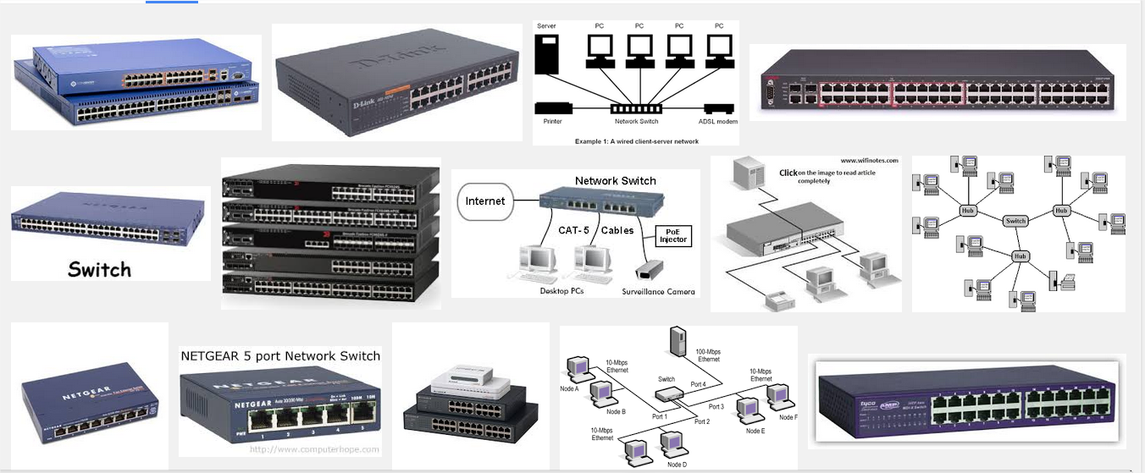
Switching Tech.

Slide 3
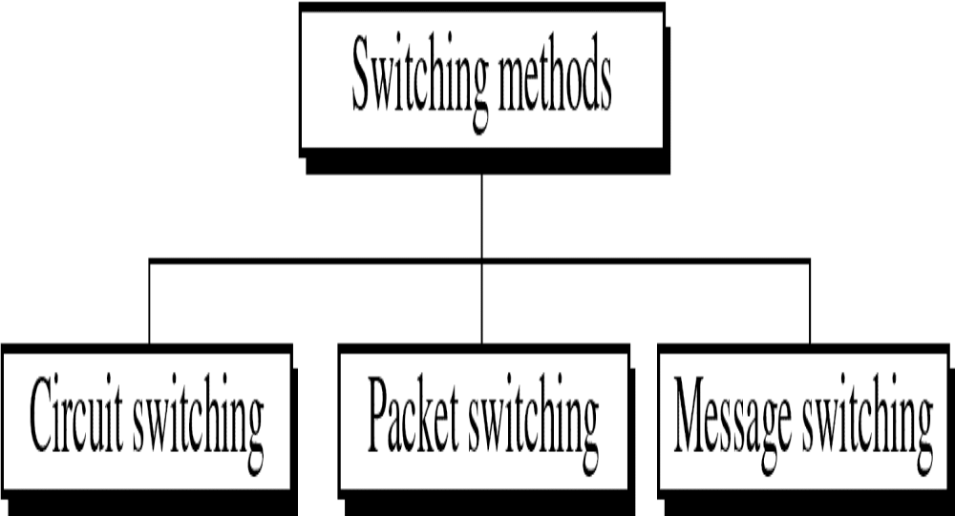
Figure 14-2
WCB/McGraw-Hill
© The McGraw-Hill Companies, Inc., 1998

Slide 4
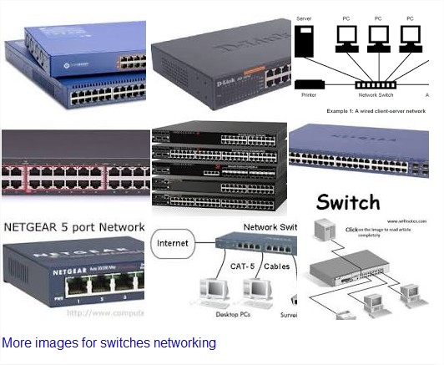

Slide 6
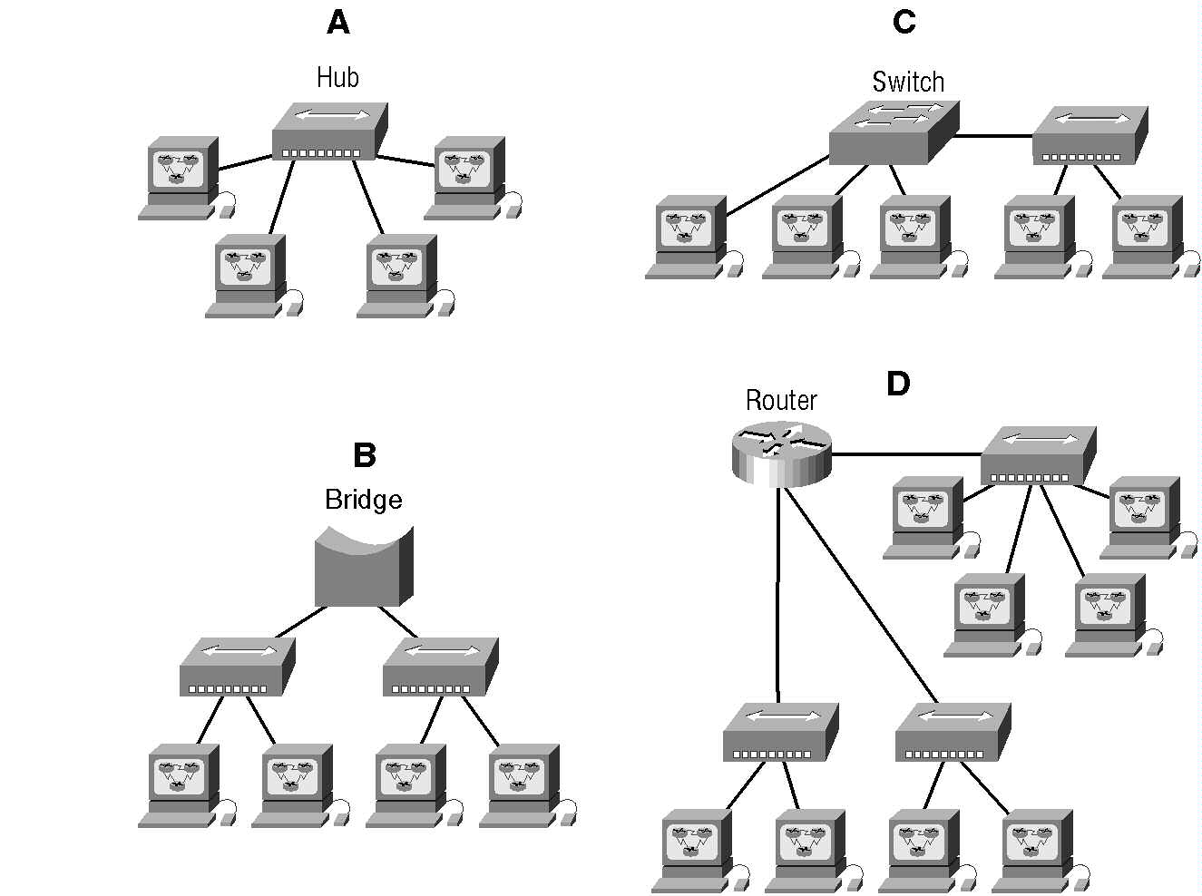
IST 228\Ch1\Internetworking

Slide 7

Switching networks is multiple paths linking sender and receiver. Information may be switched as it travels through various communication channels.
There are three typical switching techniques available for digital traffic.
  Circuit Switching
  Message Switching
  Packet Switching

Slide 8
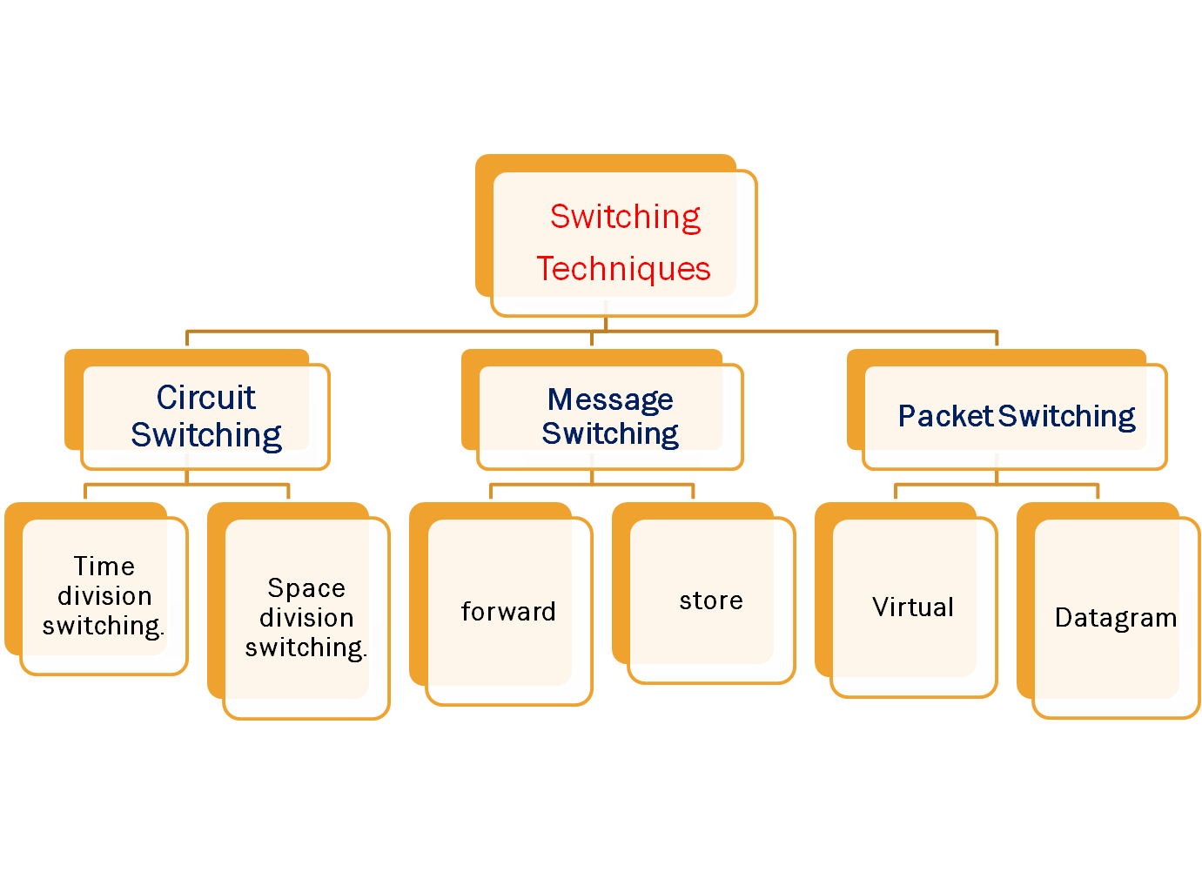

Slide 9
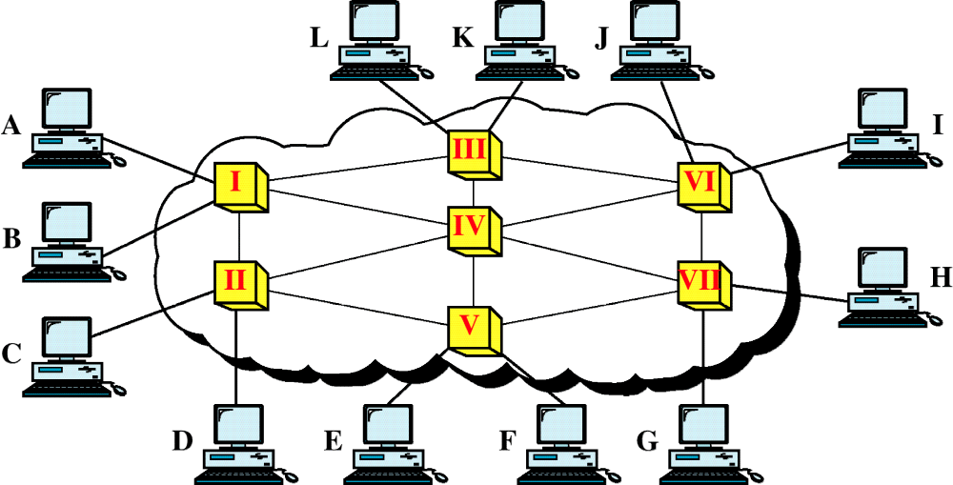
Figure 14-1
Switched Network
WCB/McGraw-Hill
© The McGraw-Hill Companies, Inc., 1998

Slide 10

Circuit switching is a technique that directly connects the sender and the receiver in an unbroken path.
Telephone switching equipment.(Materials)
Circuit-switched is a type of network in which a physical path is obtained for and dedicated to a single connection between two end-points in the network for the duration of the connection.
Two type is circuit switching:-
  Space division switching.
  Time division switching.

Slide 11
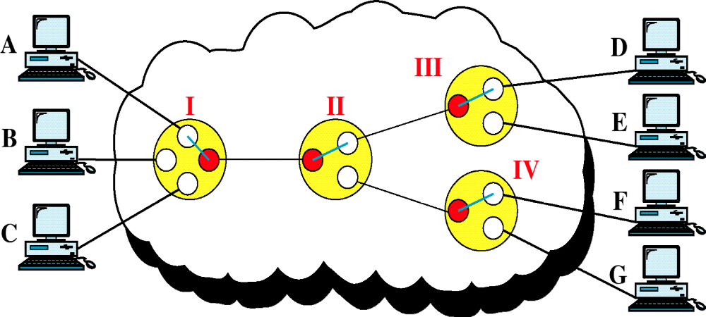
Figure 14-3
Circuit-Switched Network
WCB/McGraw-Hill
© The McGraw-Hill Companies, Inc., 1998

Slide 12

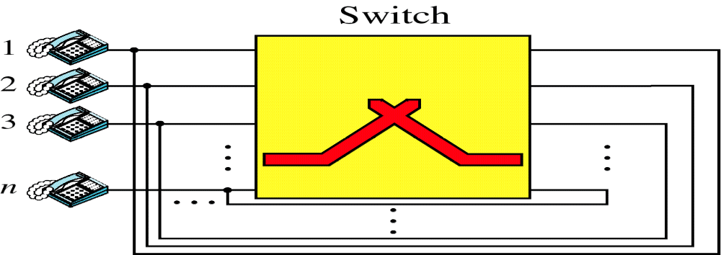
Circuit switching in a network operates almost the same way as the telephone system works.
A complete end-to-end path must exist before communication can take place.

Slide 13

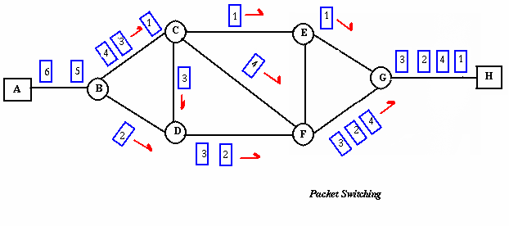
Packet switching is a method of grouping data transmitted over a digital network into packets which are composed of a header and a payload.

Slide 14

Each packet is tagged with proper source and destination
addresses.
Packet switching is a method of transferring the data to a network in form of packets.
Also the transmission speeds, between nodes, are optimized.
Two type of packet switch –Datagram and Virtual

Slide 15

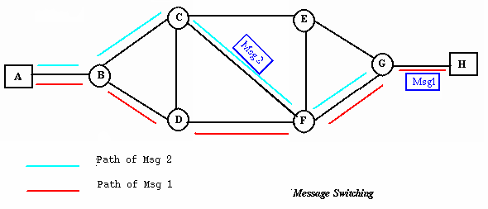
A time delay is introduced using this type of scheme due to store- and-forward time, plus the time required to find the next node in the transmission path.

Slide 16

Message switching there is no need to establish a dedicated path between two stations.
When a station sends a message, the destination address is appended to the message.
The message is then transmitted through the network, in its completeness, from node to node.
This type of network is called a store-and-forward network.

Slide 17
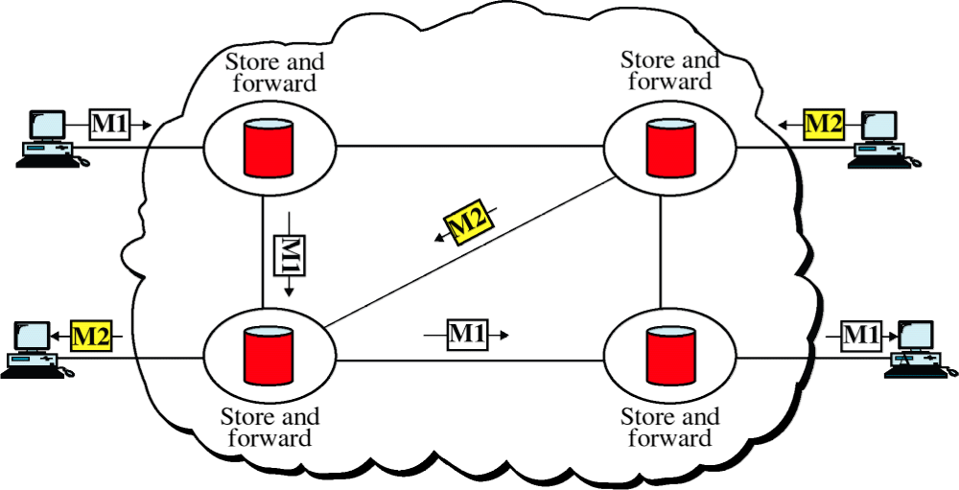
Figure 14-17
Message Switching
WCB/McGraw-Hill
© The McGraw-Hill Companies, Inc., 1998

